Slide 1

CAPSTONE PROJECT 2
BIKE SHARING DEMAND
PREDICTION
Presented by:
SANA MULANI

Slide 2
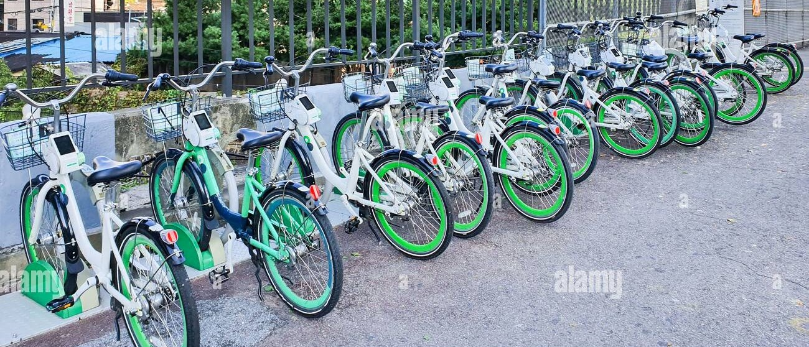
PROBLEM DESCRIPTION:
Currently Rental bikes are introduced in many urban cities for the
enhancement of mobility comfort. It is important to make the rental bike
available and accessible to the public at the right time as it lessens the
waiting time. Eventually, providing the city with a stable supply of rental bikes becomes a major concern. The crucial part is the prediction of bike count required at each hour for the stable supply of rental bikes.

Slide 3

BUSINESS UNDERSTANDING
▪ Bike rentals have became a popular service in recent years and it seems people are using it more often. With relatively cheaper rates and ease of pick up and drop at own convenience is what making this business thrive.
▪ Mostly used by people having no personal vehicles and also to avoid congested public transport that’s why they prefer rental bikes.
▪ Therefore, the business to strive and profit more, it has to be always ready and supply no. of bikes at different locations, to fulfill the demand.
▪ Our project goal is a pre planned set of bike count values that can be a handy solution to meet all demands.

Slide 4
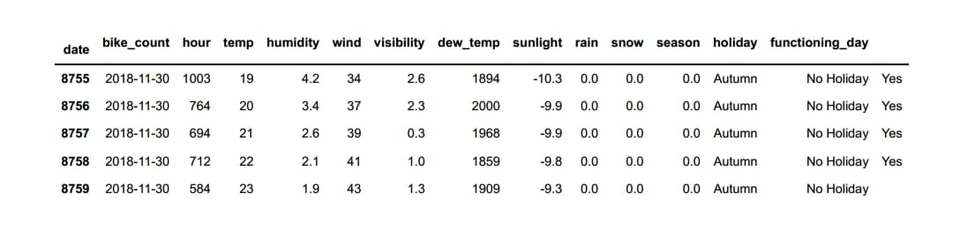
DATA SUMMARY
▪ This Dataset contain 8760 rows and 14 columns.
▪ Three categorical features ‘Seasons’, ‘Holiday’, & ‘Functioning Day’. ▪ One Datetime column ‘Date’.
▪ We have some numerical type variables such as temperature, humidity, wind, visibility, dew point temp, solar radiation, rainfall, snowfall which shows the environmental conditions for that particular hour of the day.

Slide 5
DATA SUMMARY
▪ There are No Missing Values present ▪ There are No Duplicate values present ▪ There are No null values.
▪ The dependent variable is 'rented bike count' which we need to make predictions on.
▪ The dataset shows hourly rental data for one year (1 December 2017 to 31 November 2018) (365 days).
▪ We changed the name of some features for our convenience, they are as
follows ‘date', 'Bike_Count', 'Hour’, ‘temp’, ‘humidity', ‘wind', ‘visibility’,
‘dew_temp’, ‘sunlight’, rain', ‘snow', ‘seasons', ‘holiday', ‘functioning_day’.

Slide 6
FEATURE TYPES
FEATURES
TARGET VARIABLE
NUMERIC CATEGORICAL
1.Hour 1.season
2.temp 2.holiday
3. humidity
3.Functioning day
4.wind
4.timeshift
BIKE COUNT
5.dew_temp
5.sunlight
6.rain
7.snow

Slide 7
FEATURE SUMMARY
• Date : Year-Month-Day
• Rented Bike Count - Count of bikes rented at each hour
• Hour - Hour of the day
• Temperature - Temperature in Celsius
• Humidity - %
• Wind Speed - m/s
• Visibility - 10m
• Dew point temperature -Celsius
• Solar radiation -MJ/m2
• Rainfall -mm
• Snowfall -cm
• Seasons -Winter, Spring, Summer, Autumn
• Holiday -Holiday/No Holiday
• Functional Day - NoFunc(Non Functional Hrs),Fun(Functional Hrs)

Slide 8
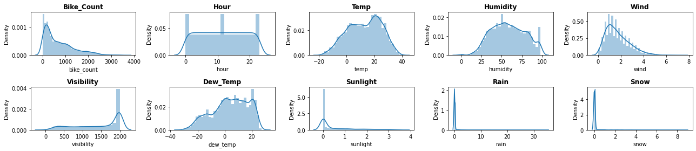
VISUALIZING DISTRIBUTIONS

Slide 9
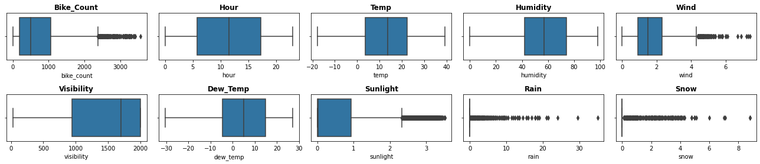
CHECKING OUTLIERS
▪ We see outliers in some columns like Sunlight, Wind, Rain and Snow but lets not treat
them because they may not be outliers as snowfall, rainfall etc. themselves are rare event
in some countries.
▪ We treated the outliers in the target variable by capping with IQR limits.

Slide 10
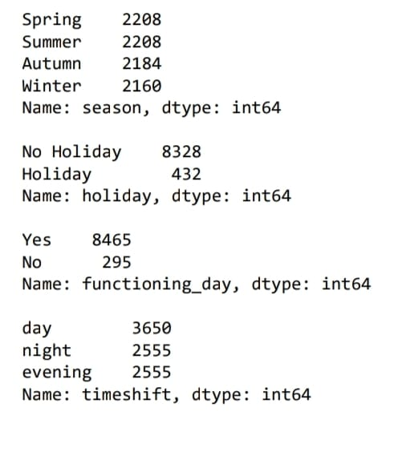
MANIPULATING THE DATASET
▪ Added new feature named weekend that shows whether it’s a weekend or not. Here Saturdays and Sundays means 1 else 0.
▪ Added one more new feature named timeshift based on time intervals. It has three values Night, Day and Evening.
▪ Dropped the date column because we already extracted some useful features from that column.
▪ Defined a label encoder to replace the string values in the columns with some numeric values.
▪ Replaced holiday with 1 and No holiday with 0.
▪ Replaced Yes with 1 and No with 0 in functioning_day column.
▪ In the timeshift column we replaced night with 0, day with 1 and evening with 2.
▪ Created dummy features from the season column named
summer, autumn, spring and winter with one hot encoding.

Slide 11
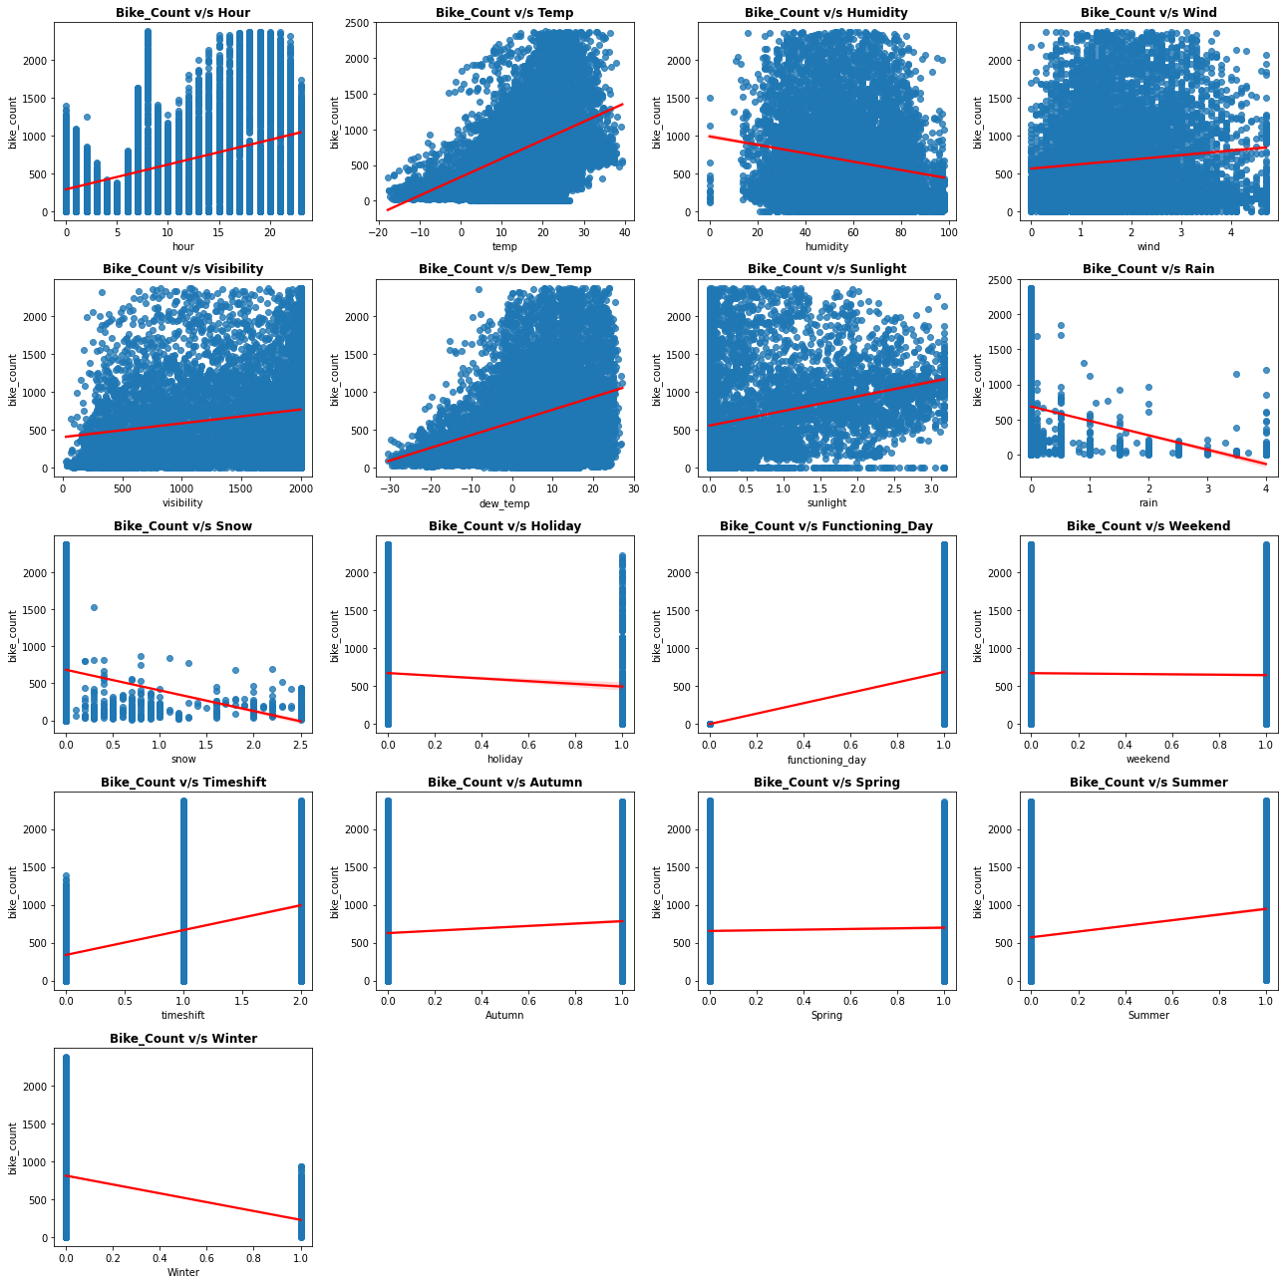
CHECKING LINEARITY IN DATA

Slide 12
CHECKING LINEARITY IN DATA
• From the visualizations we observed that hour, temp, sunlight , dew_temp is positively correlated with the bike_count.
• Humidity , rain, snow, winter features are having a negative correlation with the bike_count.
• Some features are also showing close to zero correlation with the target variable as the regression line is not inclined.

Slide 13
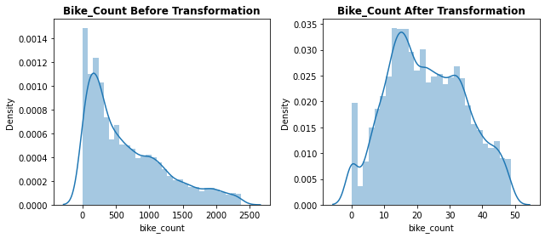
DEPENDENT VARIABLE
▪ Earlier the distribution of the target variable was positively skewed with a skewness value of 0.983. We tried to make this distribution somewhat close to normal distribution.
▪ First we applied log transformation, but it did not give the desired results, we finally applied square root transformation. We got the favourable results, the skewness value was dropped to 0.153, which is comparatively closer to the normal distribution.

Slide 14
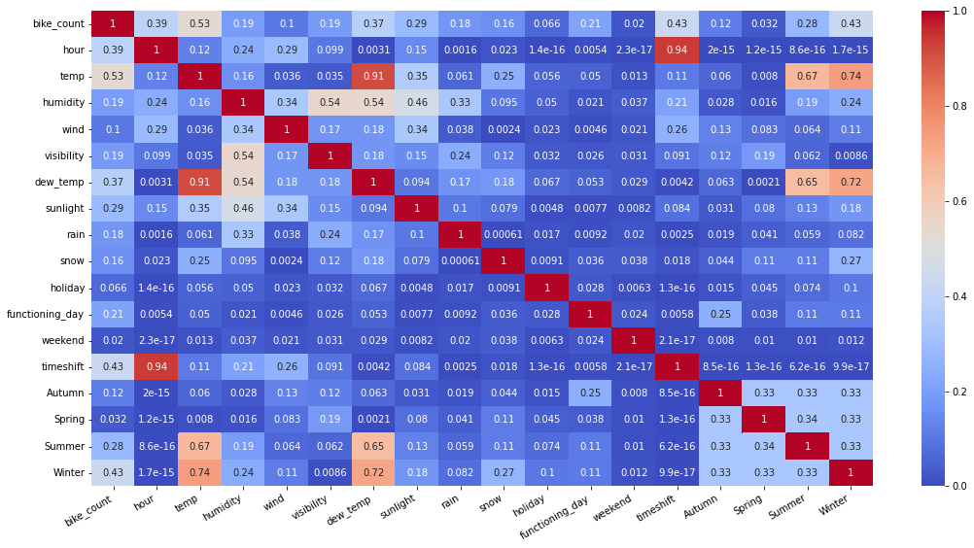
MULTICOLLINEARITY ANALYSIS

Slide 15
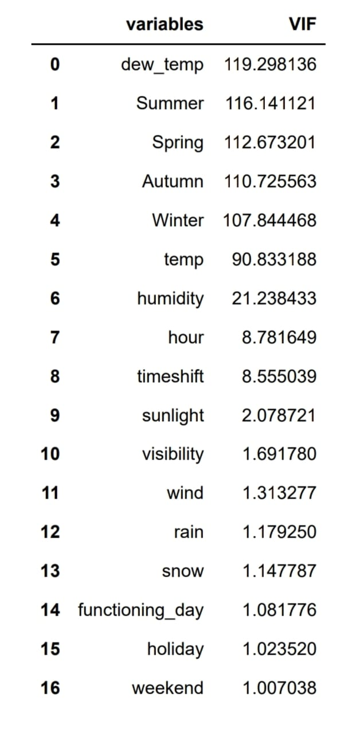
HANDLING MULTICOLLINEARITY
▪ Multicollinearity allows us to look at correlations (that is, how one variable changes with respect to another). In
words, the statistical technique that examines the
relationship and explains whether, and how strongly, pairs of variables are related to one another is known as
correlation.
▪ Dew_temp and temp are highly correlated. Hour and timeshift are also highly corelated.
▪ We can see some highly correlated features. Lets treat them by excluding them from dataset and checking the variance inflation factors.
▪ VIF determines the strength of the correlation between the independent variables. It is predicted by taking a variable
and regressing it against every other variable. VIF score of an independent variable represents how well the variable is explained by other independent variables.

Slide 16
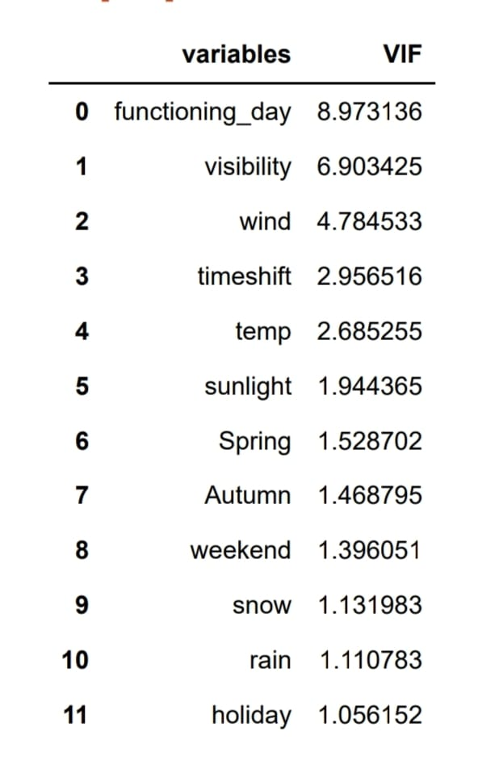
HANDLING MULTICOLLINEARITY
▪
Since Summer and Winter can also be classified on the basis
of temperature and we already have that feature present. Even if we drop these features the useful information will
not be lost. So we dropped them.
▪ We continued to exclude the features with VIF > 10 and finally we obtained the following results.

Slide 17
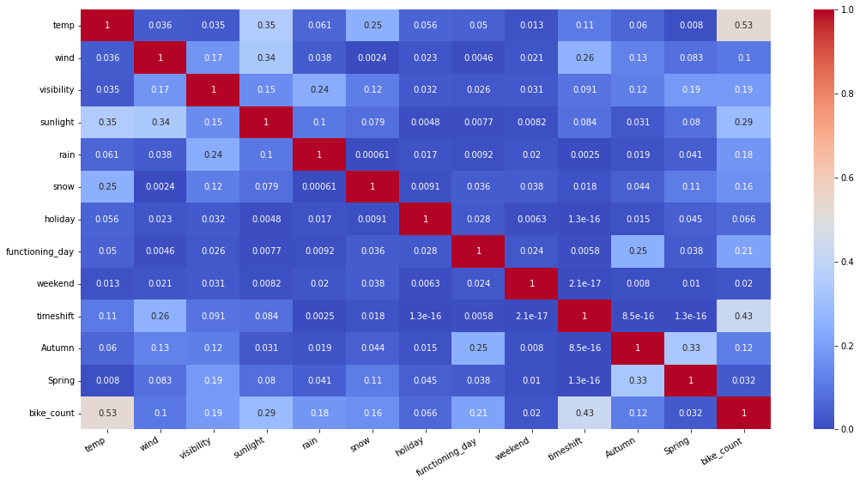
UPDATED HEATMAP

Slide 18
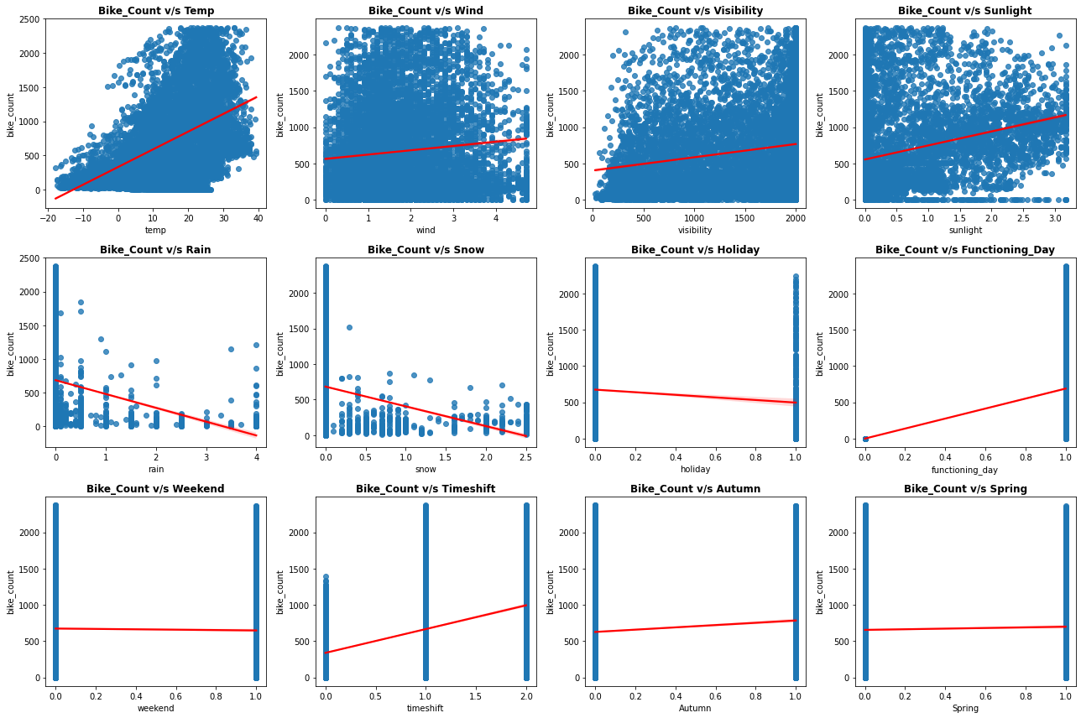
REGPLOTS (UPDATED DATASET)

Slide 19
MODEL BUILDING PREREQUISITES
▪ Feature Scaling or Standardization: It is a step of Data Pre Processing which is
applied to independent variables or features of data. It basically helps to normalise the data within a particular range. Sometimes, it also helps in speeding up the calculations in an algorithm.
▪ Here we used MinMax scaler :Normalisation scales our features to a predefined range (normally the 0-1 range), independently of the statistical distribution they follow. It does this using the minimum and maximum values of each feature in the dataset.
Xnormalised = X – Xmin/Xmax - Xmin

Slide 20
MODEL BUILDING PREREQUISITES
▪ Defining a new function called analyse_model which takes
model, X_train, X_test, y_train, y_test and prints evaluation matrix like MSE,
RMSE, MAE, TRAIN R2, TEST R2 , ADJUSTED R2. Also plots the feature importance
based on the algorithm used.
▪ We also defined some range of values for hyperparameters such as: ▪ Number of trees: n_estimators=[50,100,150]
▪ Maximum depth of trees: [6,8,10]
▪ Minimum number of samples required to split a node: [50,100,150] ▪ Minimum number of samples required at each leaf node: [40,50] ▪ learning rate : Eta=[0.05, 0.08, 0.1]

Slide 21
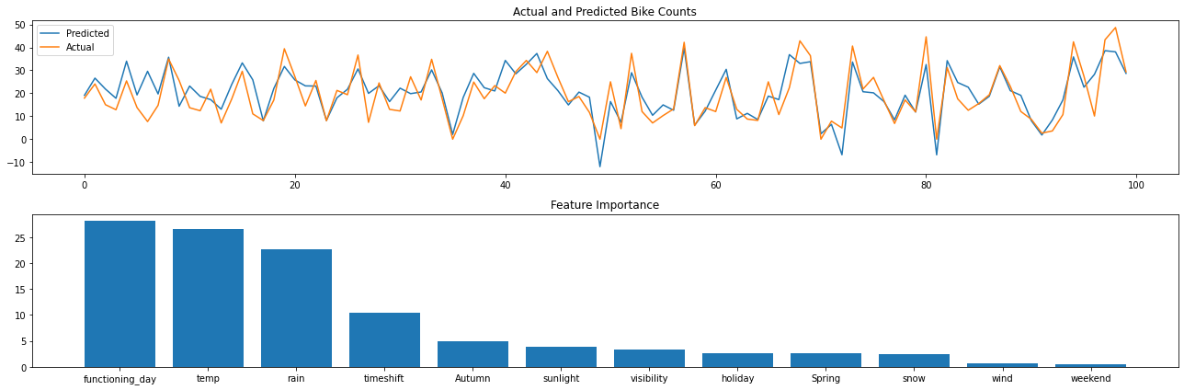
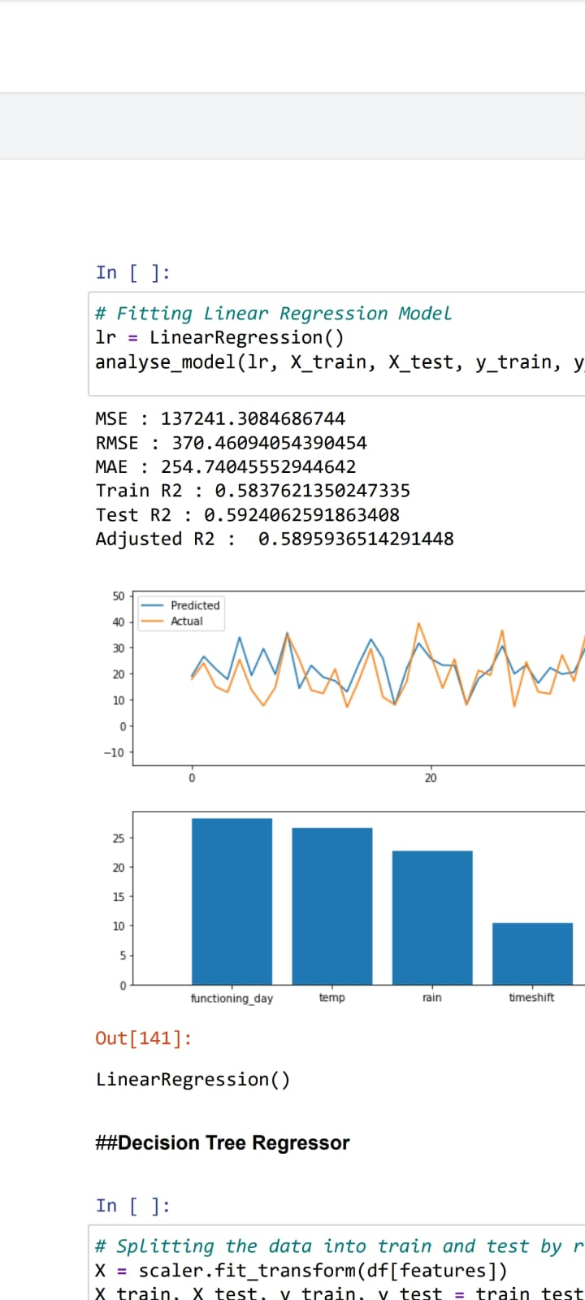
LINEAR REGRESSION
▪ We plotted the absolute values of the beta coefficients which can be seen parallel to the feature importance of tree based algorithms.
▪ Since the performance of simple linear model is not so good. We experimented with some complex models.

Slide 22
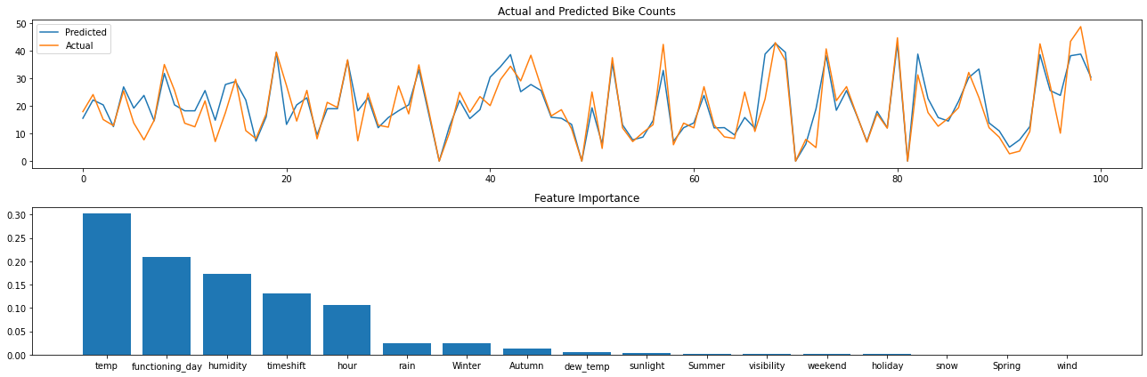
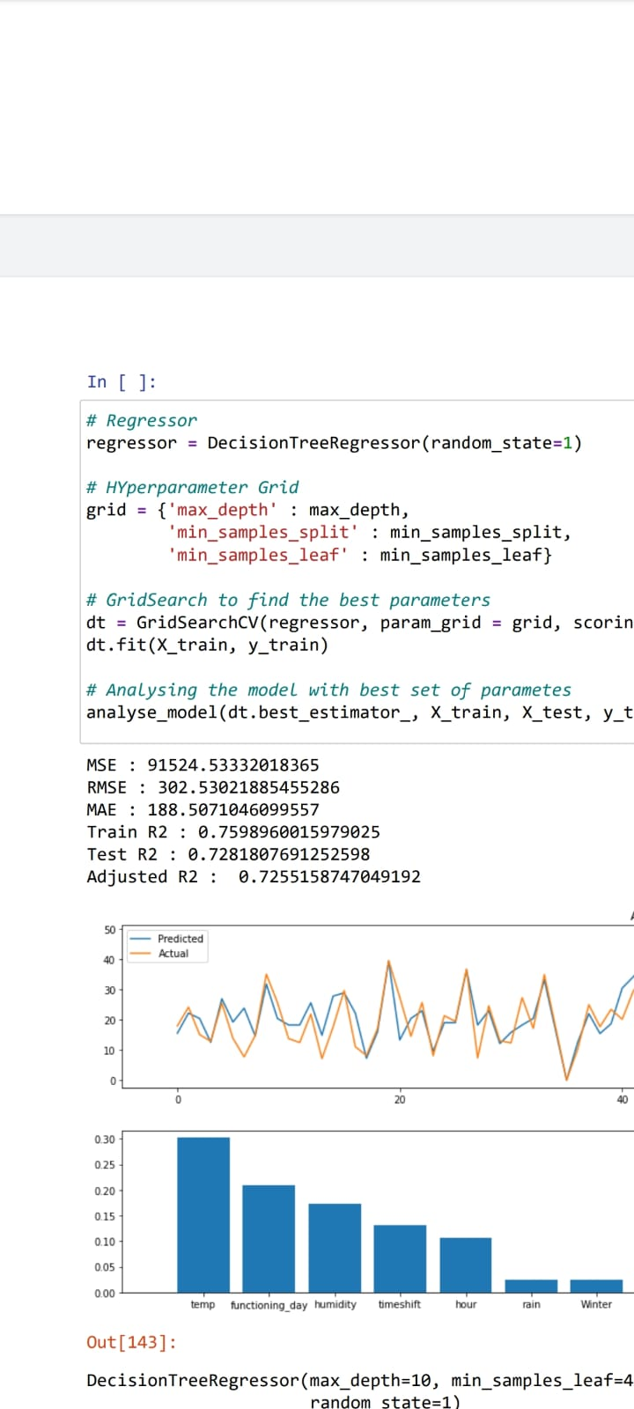
DECISION TREE
▪ DecisionTreeRegressor(max_depth=10,
min_samples_leaf=40, min_samples_split=50, random_state=1)
▪ Decision tree performs well better than the linear reg with a test r2 score more than 70%.

Slide 23
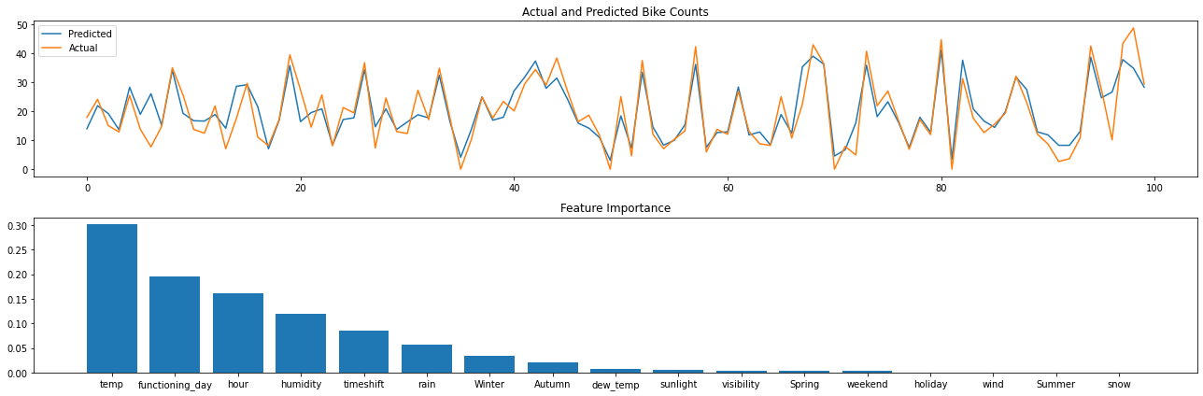
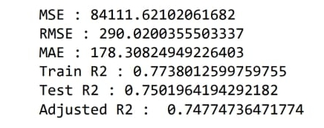
RANDOM FOREST REGRESSOR
▪ RandomForestRegressor(max_depth=10,
min_samples_leaf=40, min_samples_split=50, random_state=2)
▪ Random forest also performs well in both test and train
data with a r2 score 77% on train data and around 75% on the test data.

Slide 24
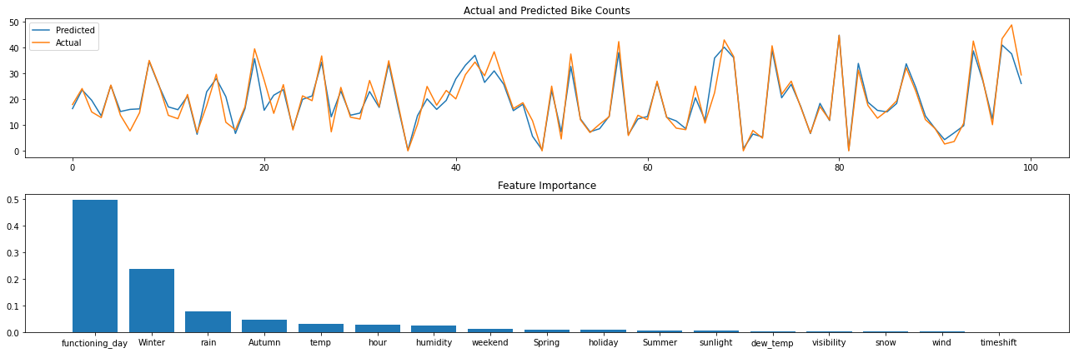
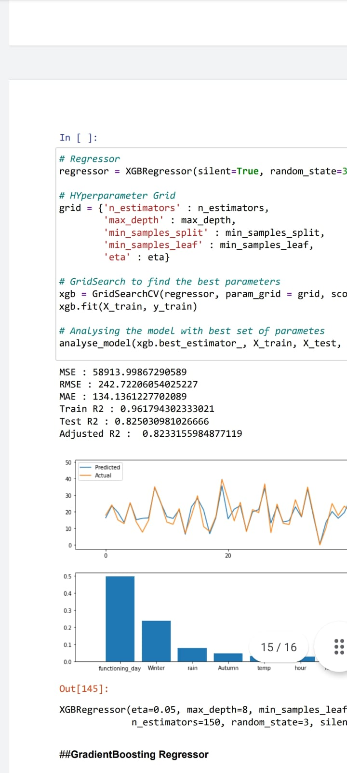
XGBOOST REGRESSOR
▪ XGBRegressor(eta=0.05, max_depth=8,
min_samples_leaf=40, min_samples_split=50,
n_estimators=150, random_state=3, silent=True)
▪ XGBoost regressor emerges as the best model according to the evaluation matrix score both in the train and test.

Slide 25
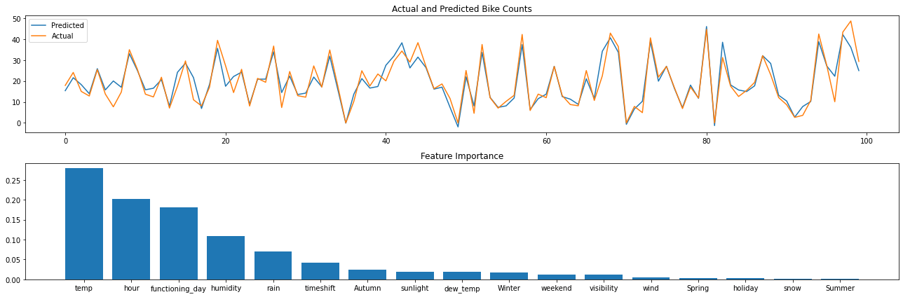
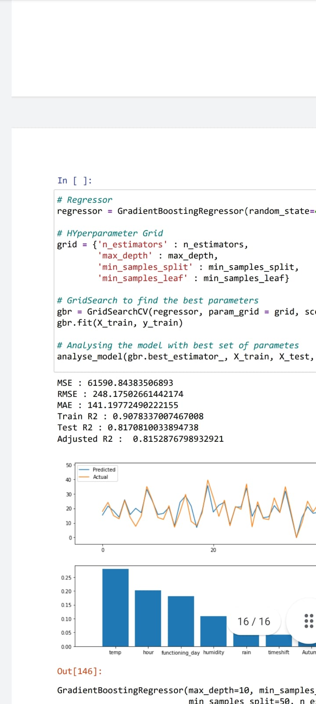
GRADIENT BOOSTING REGRESSOR
▪ GradientBoostingRegressor(max_depth=10,
min_samples_leaf=50, min_samples_split=50,
n_estimators=150, random_state=4)
▪ We experimented this boosting algorithm in order to
enhance the performance but we found out that its
performance is closely equal to the XGBoost model only.

Slide 26
CONCLUSION
▪ The independent variables in data given does not have a good linear relation with the target variable so the simple linear model was not performing good on this data. Tree based Algorithms seem to perform well in this case.
▪ Functioning day is the most influencing feature and temperature is at the second place for LinearRegressor.
▪ Temperature is the most important feature for DecisionTree, RandomForest and GradientBoosting Regressor.
▪ Functioning day is the most important feature and Winter is the second most for XGBoostRegressor.
▪ The feature temperature is on the top list for all the regressors except XGBoost. ▪ XGBoost is acting different from all the regressors as it is considering whether it is winter or not. And is it a working day or not. Though winter is also a function of
temperature only but it seems this trick of XGBoost is giving better results.
▪ XGBoostRegressor has the Least Root Mean Squared Error (242.72). So It can be considered as the best model for given problem.

